Slide 1
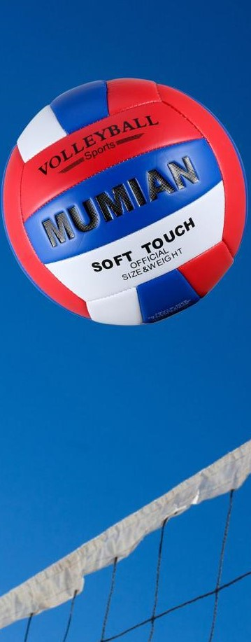
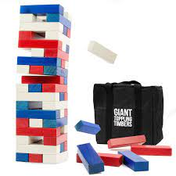
Westside High School
Feb.27-Mar 3 Week At a Glance (WAG)

Slide 2
Coach Thomas
Rec. Games: Feb.27-Mar 3

Slide 3
Monday - Agenda
Learning Target
I can use proper technique for stretching
I can use strategy to compete in relay while also working as a team
I can work with partner to participate in basketpong and ladder toss
Feb. 27 Block schedule
Standard:
Opening ( 10-15 mins)
Student will go through stretches with coaches' lead
Work-session ( 20 - 25 mins)
Review of station/circuit exercises & students will go 30 seconds for each station
2. Possible Relay
3. Players partnered up to compete in basketball pong and ladder toss with teams being chosen to officiate/keep score and make sure rules are followed
4. Free play if time permits
Criteria for Success
Students can use proper technique to perform exercises
I can explain and follow the rules for basketball pong and ladder toss
Closing ( 05 – 10 mins)
Cool down

Slide 4
Tuesday - Agenda
Learning Target
Feb. 28 Standard: Block
PERG.1 The physically educated student demonstrates competency in a variety of motor skills and movement patterns.
a. Demonstrates competence while performing skills in a variety of recreational game settings and activities
b. Performs skills at a level of competence, which contributes to health-related fitness.
c. Demonstrates proper warm-up and cool-down protocol associated with different life time
sport physical activities.
PERG. 2 The physically educated student applies the knowledge of concepts, principles, strategies, and tactics related to movement and performance.
Integrates a variety of strategies, tactics, concepts, and skills during recreational games activities
Evaluates skills needed for recreational games and leisure activities
PERG.3 The physically educated student demonstrates knowledge and skills to help achieve
and maintain a health-enhancing level of physical activity and fitness.
a. Maintains or improves fitness level by using the results of the Georgia Fitness Assessment
to guide changes in a personal program of physical activity.
b. Uses technologies to assess, enhance, and maintain health-related and skill-related fitness.
c. Analyzes the relationship between physical activity and longevity.
Personal and Social Behavior, Rules, Safety, and Etiquette
Same as previous day
Opening ( 10-15 mins)
5-10 minute static & dynamic stretches (5 minutes locker rooms)
Work-session ( 20 - 25 mins)
Same as previous day
Criteria for Success
Same as previous day
Closing ( 05 – 10 mins)
locker room unlocked for 5 minutes
-students use remaining time to cool down & rehydrate if necessary

Slide 5
Wednesday - Agenda
Learning Target
Mar 1 Standard: Block Schedule
PERG.1 The physically educated student demonstrates competency in a variety of motor skills and movement patterns.
a. Demonstrates competence while performing skills in a variety of recreational game settings and activities
b. Performs skills at a level of competence, which contributes to health-related fitness.
c. Demonstrates proper warm-up and cool-down protocol associated with different life time
sport physical activities.
PERG. 2 The physically educated student applies the knowledge of concepts, principles, strategies, and tactics related to movement and performance.
Integrates a variety of strategies, tactics, concepts, and skills during recreational games activities
Evaluates skills needed for recreational games and leisure activities
PERG.3 The physically educated student demonstrates knowledge and skills to help achieve
and maintain a health-enhancing level of physical activity and fitness.
a. Maintains or improves fitness level by using the results of the Georgia Fitness Assessment
to guide changes in a personal program of physical activity.
b. Uses technologies to assess, enhance, and maintain health-related and skill-related fitness.
c. Analyzes the relationship between physical activity and longevity.
Personal and Social Behavior, Rules, Safety, and Etiquette
Same as Monday
Opening ( 10-15 mins)
Static & Dynamic Stretches
Work-session ( 20 - 25 mins)
Same as Monday
If we get the equipment, we may incorporate ultimate Frisbee for frisbee frenzy
Criteria for Success
Closing ( 05 – 10 mins)
Same as Monday
-locker room unlocked for 5 minutes
-students use remaining time to cool down & rehydrate if necessary

Slide 6
Thursday - Agenda
Learning Target
Same as previous day
Mar 2 Standard:
PERG.1 The physically educated student demonstrates competency in a variety of motor skills and movement patterns.
a. Demonstrates competence while performing skills in a variety of recreational game settings and activities
b. Performs skills at a level of competence, which contributes to health-related fitness.
c. Demonstrates proper warm-up and cool-down protocol associated with different life time
sport physical activities.
PERG. 2 The physically educated student applies the knowledge of concepts, principles, strategies, and tactics related to movement and performance.
Integrates a variety of strategies, tactics, concepts, and skills during recreational games activities
Evaluates skills needed for recreational games and leisure activities
PERG.3 The physically educated student demonstrates knowledge and skills to help achieve
and maintain a health-enhancing level of physical activity and fitness.
a. Maintains or improves fitness level by using the results of the Georgia Fitness Assessment
to guide changes in a personal program of physical activity.
b. Uses technologies to assess, enhance, and maintain health-related and skill-related fitness.
c. Analyzes the relationship between physical activity and longevity.
Personal and Social Behavior, Rules, Safety, and Etiquette
Opening ( 10-15 mins)
Static & Dynamic stretching
Work-session ( 20 - 25 mins)
Same as previous day
Criteria for Success
Closing ( 05 – 10 mins)
Same as previous day
-locker room unlocked for 5 minutes
-students use remaining time to cool down & rehydrate if necessary

Slide 7
Friday - Agenda
Learning Target
Mar 3 Standard:
PERG.1 The physically educated student demonstrates competency in a variety of motor skills and movement patterns.
a. Demonstrates competence while performing skills in a variety of recreational game settings and activities
b. Performs skills at a level of competence, which contributes to health-related fitness.
c. Demonstrates proper warm-up and cool-down protocol associated with different life time
sport physical activities.
PERG.3 The physically educated student demonstrates knowledge and skills to help achieve
and maintain a health-enhancing level of physical activity and fitness.
a. Maintains or improves fitness level by using the results of the Georgia Fitness Assessment
to guide changes in a personal program of physical activity.
b. Uses technologies to assess, enhance, and maintain health-related and skill-related fitness.
c. Analyzes the relationship between physical activity and longevity.
Personal and Social Behavior, Rules, Safety, and Etiquette
Freestyle Friday
Opening ( 10-15 mins)
Attendance
Work-session ( 20 - 25 mins)
Students are able to engage in various activities/sports typically those that they are most interested
Teacher will conference will students and possibly make parent phone calls/contact as needed
Criteria for Success
I can demonstrate my understanding of the rules, procedures, and expectations by following them during class time and asking questions to teacher if necessary.
Closing ( 05 – 10 mins)
N/A

Slide 8
Resources
https://www.youtube.com/watch?v=az_oouQa6VY

